Slide 1

Experiential Learning
Project Assessment-I on
” under the course
Python Programming Language (N-PCCCM304P)
Presented By:
Nayan Pannase
[CM25035]
Under the Guidance
of
Mrs. Mayuri Getme
Session:2026-27 (ODD )
Department of CSE(AI&ML)
S. B. JAIN INSTITUTE OF TECHNOLOGY MANAGEMENT AND RESEARCH,NAGPUR
An Autonomous Institute, Affiliated to RTMNU, Nagpur

Slide 2
Contents

Slide 3
1. Problem Statement
Develop a simple chatbot using Python that can interact with users through text input.
The chatbot should recognize and respond to predefined greetings such as “Hello,” “Hi,” and “Good morning.”
The chatbot should answer a set of predefined questions such as “What is your name?” and “How are you?”
The system should continuously accept user input until the user decides to end the conversation.
The chatbot should provide a suitable default response when it does not understand the user's input.
The program should use Python conditional statements to identify different types of user inputs.
The chatbot should use a looping mechanism to maintain continuous interaction with the user.
The program should provide specific exit commands, such as bye, exit, or quit, to terminate the conversation.
The chatbot should demonstrate basic Python programming logic, including variables, strings, conditions, loops, functions, and input/output operations.

Slide 4
2. Objective
To understand the basic concepts of Python programming.
To create an interactive chatbot using Python.
To use input() and print() for user interaction.
To apply conditional statements such as if, elif, and else.
To use loops for continuous interaction.
To handle predefined greetings and questions.
To provide an option for the user to exit the chatbot.
To understand basic Git and GitHub workflow.
To practice meaningful commits and collaboration.
To understand individual contribution in a software project.

Slide 5
3. Algorithm
Start the program.
Display a welcome message.
Continuously ask the user to enter a message.
Convert the input into lowercase to make matching easier.
Check whether the user wants to exit.
If the input is a greeting, display a predefined greeting response.
If the input matches a predefined question, display the corresponding answer.
If the chatbot does not recognize the input, display a default response.
Repeat the process until the user enters an exit command.
Display a goodbye message.
Stop the program.

Slide 6
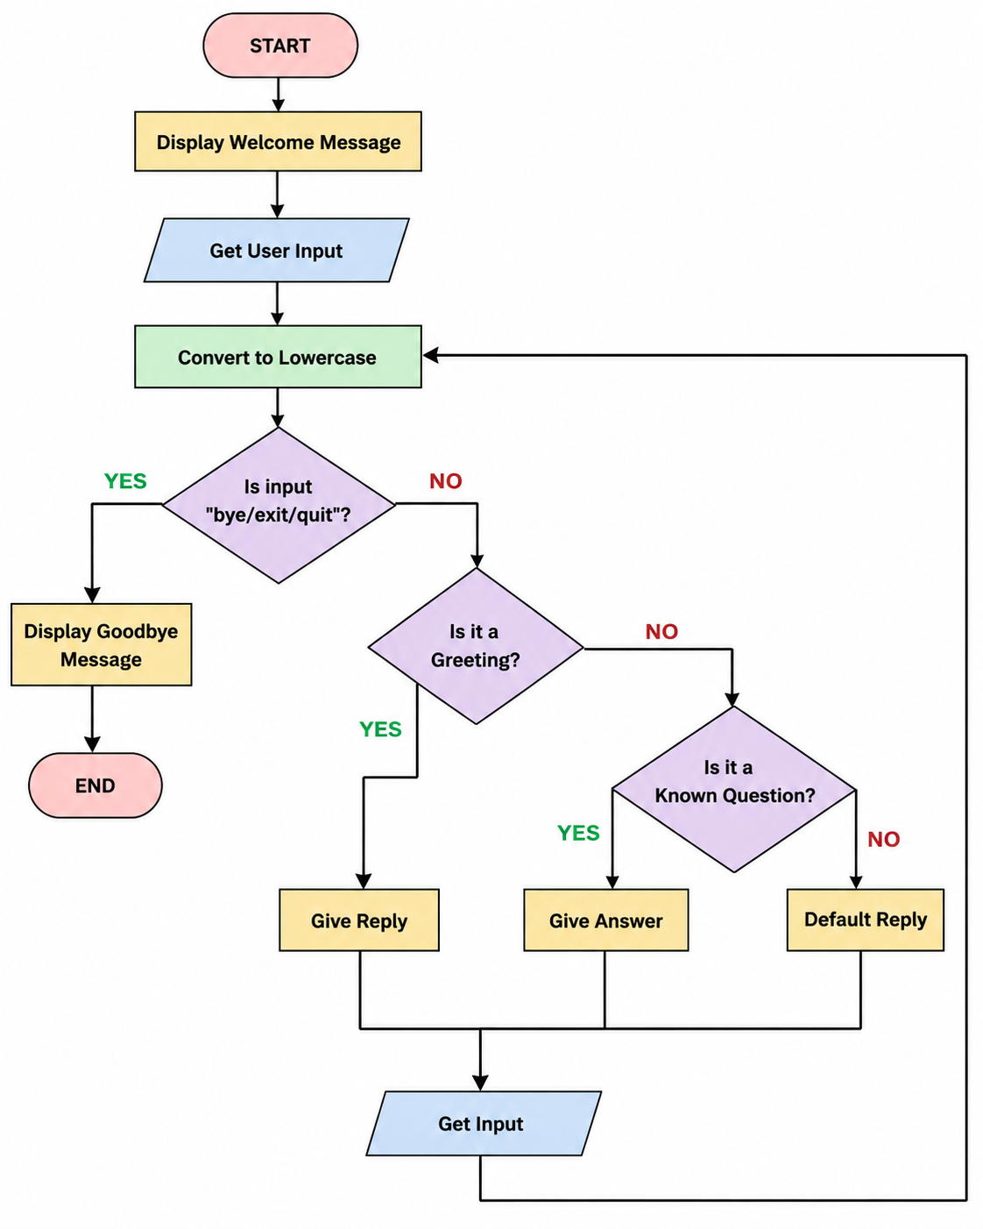
4. Flowchart

Slide 7
5. Understanding of python logic
The chatbot demonstrates several fundamental Python concepts:
Variables: Store user input and chatbot responses.
input(): Accepts text from the user.
print(): Displays messages on the screen.
while loop: Keeps the chatbot running continuously.
if, elif, else: Makes decisions based on the user's input.
String methods: lower() converts input to lowercase so that Hello, HELLO, and hello can be treated similarly.
Lists: Can store multiple greetings or exit commands.
Functions: Can be used to organize chatbot logic into reusable sections.

Slide 8
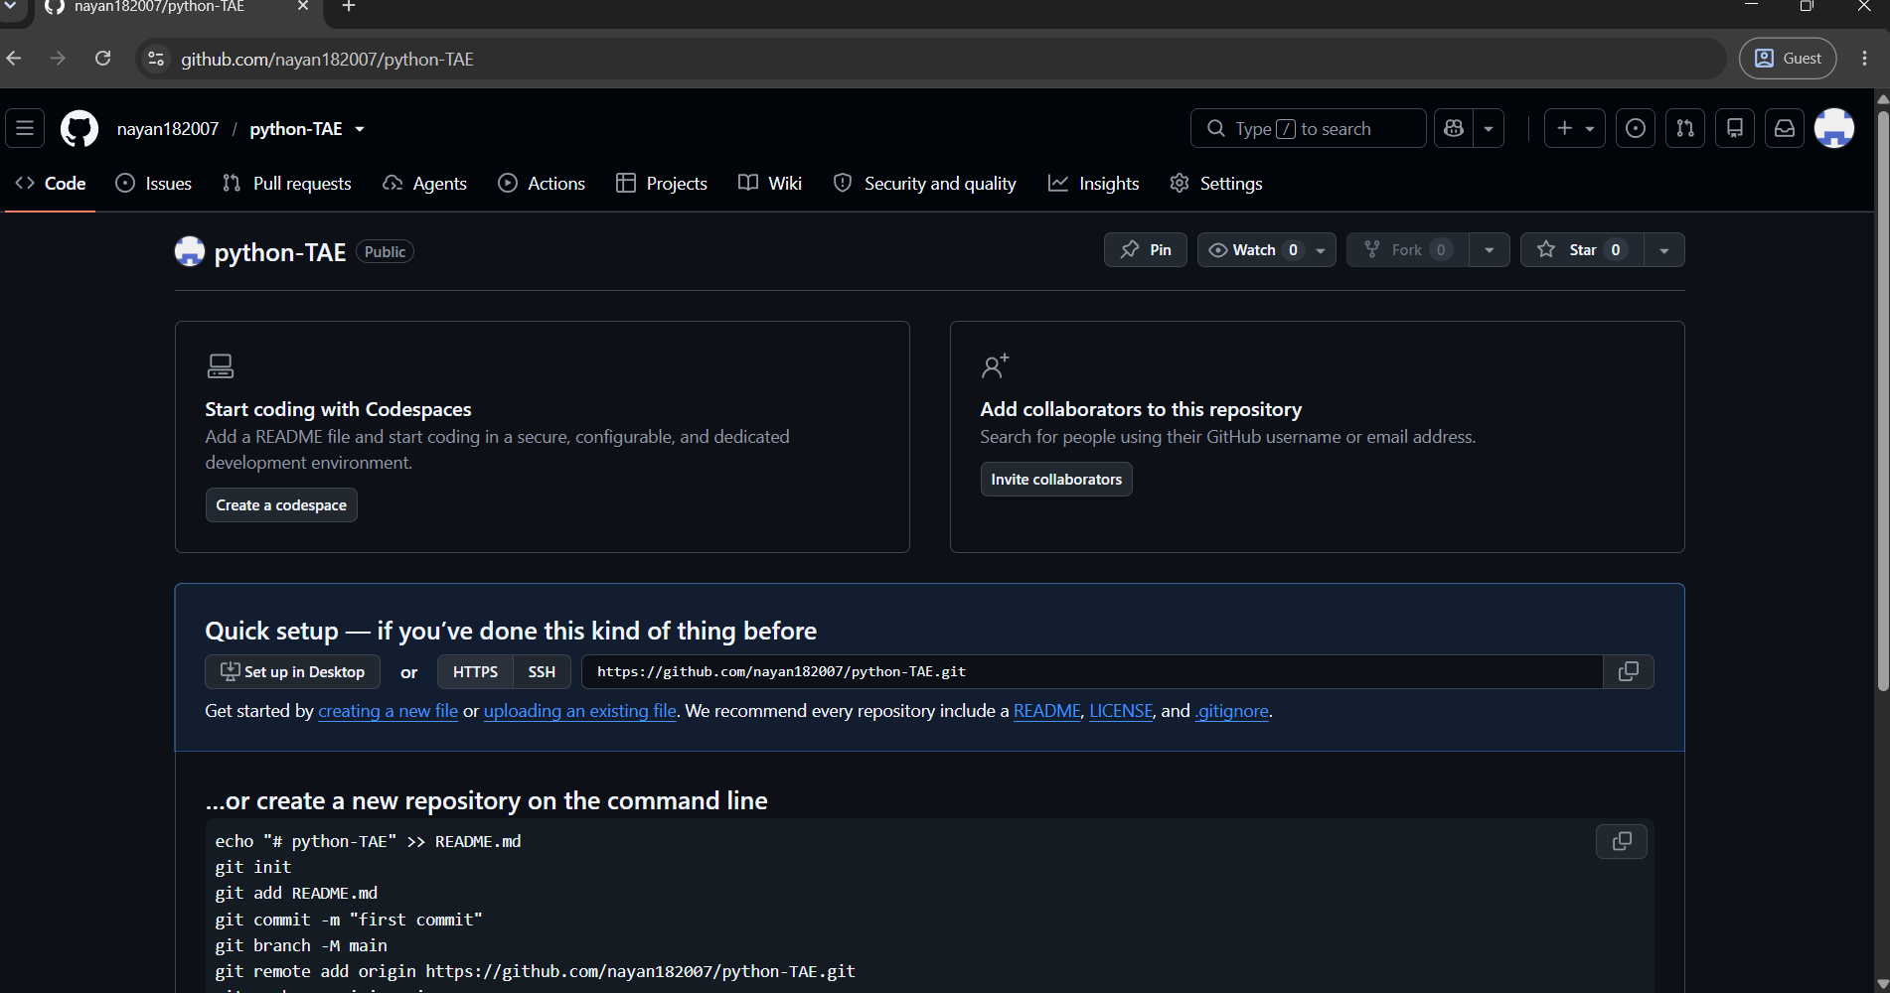
7. GitHub Account, Repository & Collaboration
https://github.com/nayan182007/python-TAE

Slide 9
print("Welcome to Python Chatbot!")
while True:
user = input("You: ").lower()
if user in ["bye", "exit", "quit"]:
print("Bot: Goodbye! Have a nice day!")
break
elif user in ["hello", "hi", "hey"]:
print("Bot: Hello! How can I help you?")
elif user == "good morning":
print("Bot: Good morning!")
elif user == "what is your name?":
print("Bot: My name is Python Chatbot.")
elif user == "how are you?":
print("Bot: I am fine. Thank you!")
elif user == "who created you?":
print("Bot: I was created using Python.")
else:
print("Bot: Sorry, I don't understand.")

Slide 10
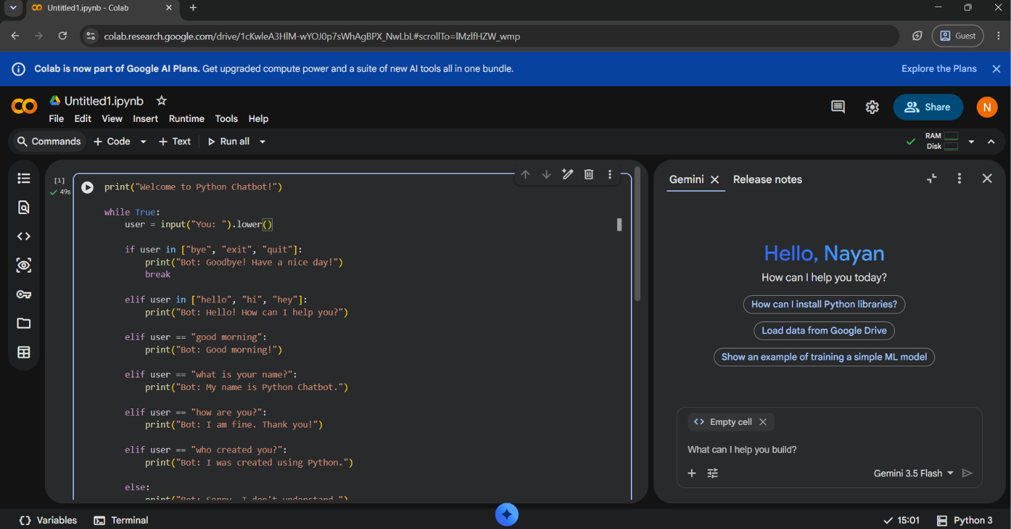
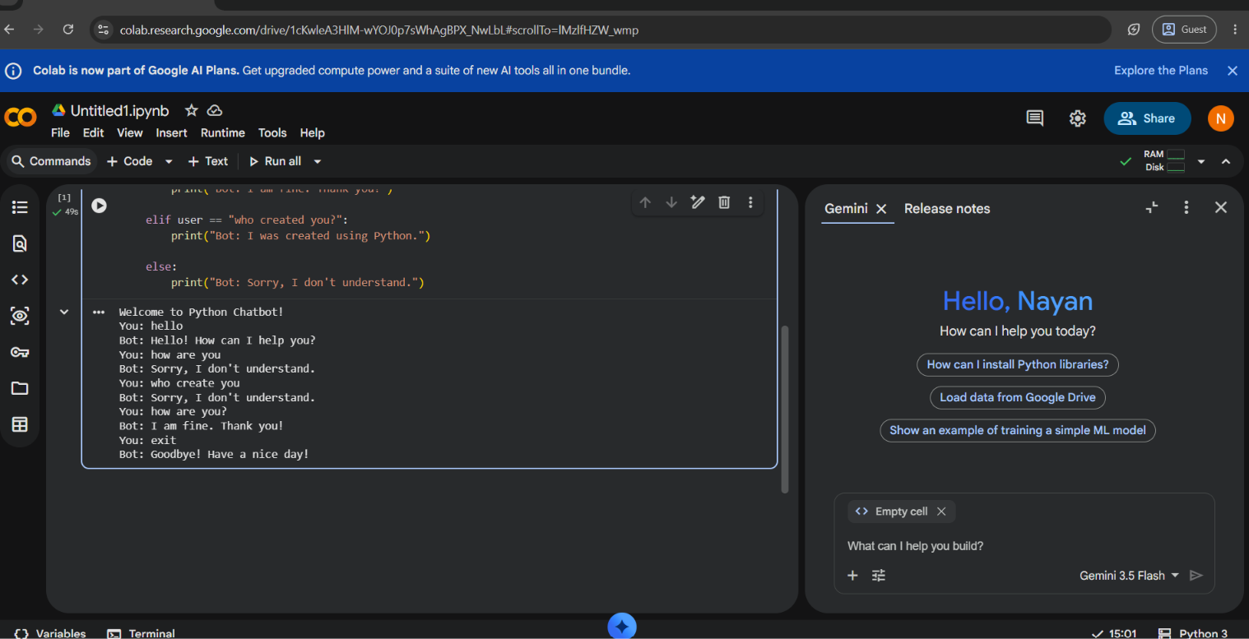

Slide 11
Thank You

